Slide 1
QA & 近況
Statistical Mechanics of Competitive Resource Allocation using Agent-based Model 2015
Modeling Market Mechanism with Evolutionary Games 1998
Statistical mechanics of systems with heterogeneous agents: Minority Games 1999
Exact solution of a modified El Farol’s bar problem: Efficiency and the role of market impact
1999
Continuum time limit and stationary states of the Minority Game
2001

Slide 2
摘要/Abstract
結果
MG group with actually trading
1.Open & Close system
Wealth equation in close system
→Wealth is not a conserve quantity ok
2. Wealth equation in open system
1.Market maker
2. Wealth equation in open system
Consist of 3 parts
i. Total cash flow with market maker ok
ii. Raise/Decay of assert depends on initial holding position ok
iii. The present value of total assert flow with market maker ok
3.Phase diagram in MG group
i. Herding
ii. Good adaptive
iii. Frozen
iv. Random
Individual agent $2 and MG behave in two phase
α < α_{c} phase
Open
background reason ok
Probability ok
With out round trip rule?
Strategy different ok
Close
4.α> α_{c} phase

Slide 3
結果
1.MG-Open system(with market maker)
Equation- delta wealth ok
Consist of 3 parts
i. Total cash flow with market maker
ii. Raise/Decay of assert depends on initial holding position ok
iii. The present value of total assert flow with market maker ok
2.MG-Close system Wealth Analysis
i. Wealth is not a conserve quantity ok
3.Why the $2 is better than MG
Open
background reason ok
Probability ok
With out round trip rule?
Strategy different ok
Close
4.α> α_{c} phase
探討為何一整群Minority game的玩家總體而言總是輸錢給market maker
分析
需要了解MG在相圖中實際代表的意義
0.Global efficiency ok P.3
1.Herding (crowding) ok P.4
2.Coin toss limit
3.臨界點
4.frozen
論文
目前寫到原理
考慮 why is there a critical point的數學論述較完整(主要)
且reduced set of strategy 不同s臨界點不同(補充)
Q : why is there a critical point P.4,P6,P7

Slide 4
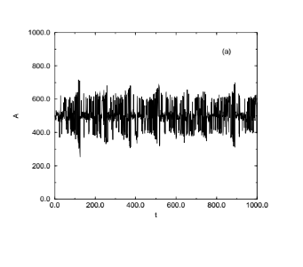
Global efficiency
1.極端情況
Set N =101
較大的漲落，意即當局得分的人數較少，將此視為系統效率較低
反過來說
較小的漲落，意即當局得分的人數較多，將此視為系統效率較高
結論
In minority mechanism, no one get “win”
將整個賽局視為一個社會情況，實際作為上 沒有人得分

Slide 5
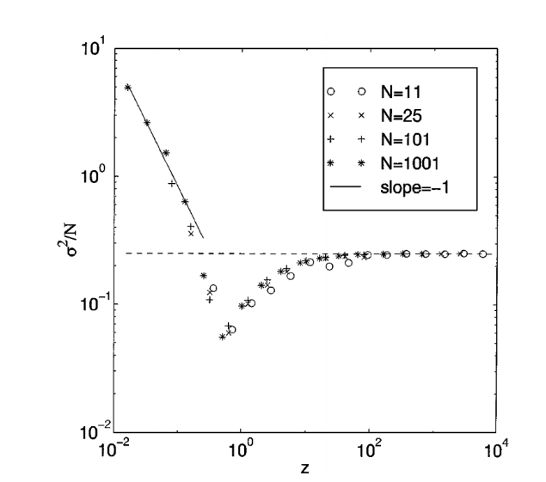
Phase diagram
For fix N P<<N
P較小時，agent分析能力較差，具體展現為
P<<N時，即經濟情況總數較少，此時從策略空間(個數為2^{P})張策略表中挑出N*S張策略表，此時容易挑到重複的策略表，選擇時經常發生撞車現象(例如這一輪買得贏了，因策略表相同倍加到分，導致下一回合都採取相同的動作，因此造成漲落常常大起大落，也被稱為羊群效應
Key word
(herding effect/crowd effect/策略空間擁擠)
討論
我覺得這部分物理概念蠻完整的，可以放入論文
討論
我覺得這部分物理概念還可，不過缺少一點說服力，希望補足一些數學
(可從reduced set of strategy space)
For fix N P>>N
P較大時，agent分析能力較好，然而
P>>N時，經濟情況總數非常多，此時從策略空間(個數為2^{P})張策略表中挑出N*S張策略表，此時幾乎不會挑到同樣的策略表，策略表之間彼此完全沒有關聯性，因此玩家在選擇買賣時看起來幾乎是隨機的，達到擲硬幣極限
Key word (coin-toss-limit/策略空間稀疏)
討論
物理概念太模糊
希望從why there is a critical point的數學中得到完整的看法
For fix N
當P增加時，agent分析能力增加，使得漲落變小，社會系統效率變好，使漲落量值小於random
For fix N
在過了臨界點之後，agent分析能力變得太好
聰明反被聰明誤，使得猜錯的機會增加，也使漲落增加

Slide 6
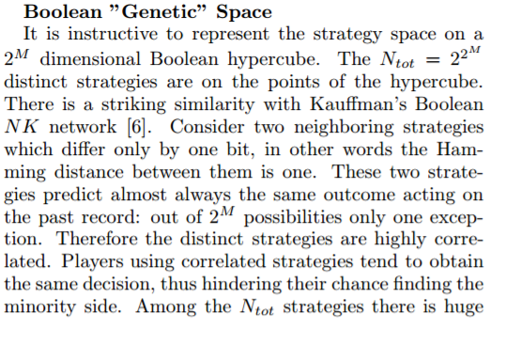
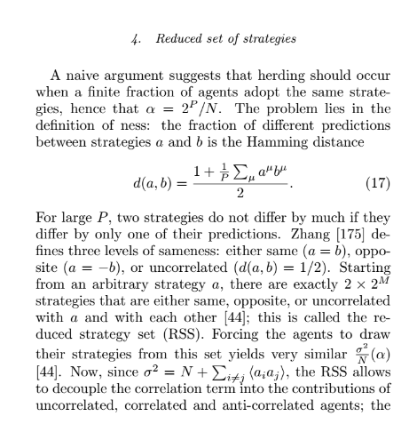
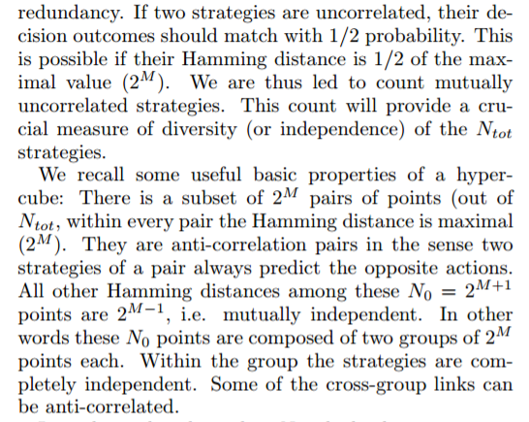
Reduced set of strategy space
如何理解
Uncorrelated的steategy總共有

Slide 7

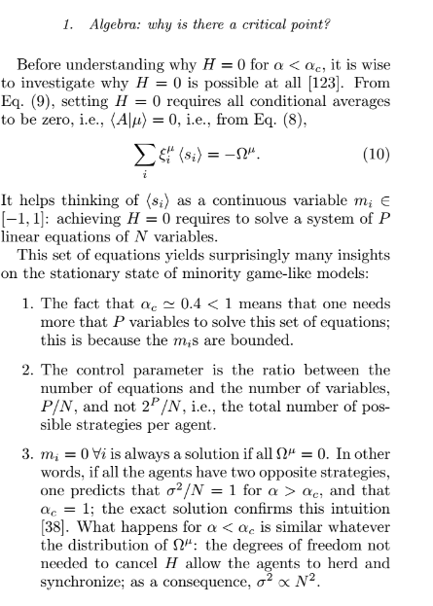
老師，solve a system of P linear equations of N variables這裡看不太懂?

Slide 9
Statistical mechanics of systems with heterogeneous agents: Minority Games 1999
為何是1/2?????

Slide 11
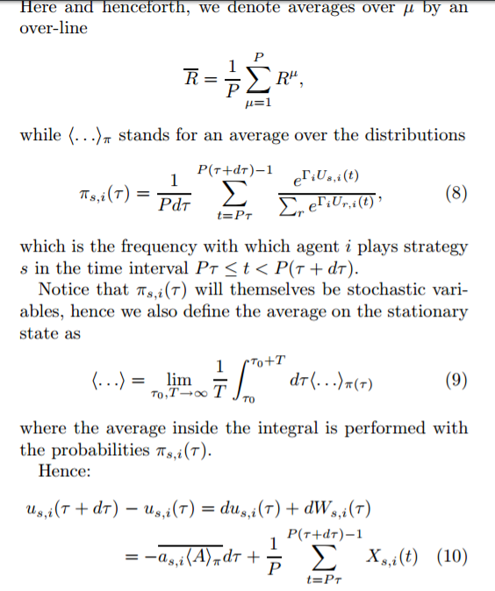
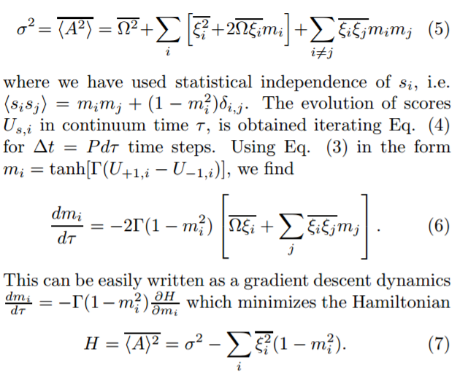
如何具體表達
<….>pi
Continuum time limit and stationary states of the Minority Game
應該對理解P.7 Q
有幫助

Slide 12
The background
1. See all agents as a group
The holding position of all agent
In micro sight
After match
Exceed demand trade with market maker

Slide 13
The background
假設沒有借出股票的行為，holding position恆正
則系統中全部agent在t,t-1財富量變化完全受到價格差的影響，擁有的股票數則可視為影響的權重
單純討論t,t-1時刻的分別
1.價格漲時，財富量必增加
2.價格跌時，財富量必減少

Slide 14
Open system → Close system
Exceed demand, trade with market maker !
Consider a close market, agent only trade with each other
1.Exceed demand would NOT be get.
2.But exceed demand is about sent order, will affect on price
Mathematically, B.C is given.
For all time step t

Slide 15
Close system The background 股市市值蒸發及膨漲
1.The wealth of system/agent is NOT a conserve quantity.(but the cash is)
2.The wealth decay/rise immediately with price fluctuation.

Slide 16
Open system The background for all time t
Delta wealth of system consist of 3 part
1.Total cash flow with market maker
2.Raise/Decay of assert depends on initial holding position
3.The present value of total assert flow with market maker

Slide 17
Analysis of open system
Second term is purely raise/decay of the initial assert which the same in close system
Interestingly, first term and third term are a pair of non-risky assert and risky assert due to the total extra trade with market maker.
3.Since p(T) behave randomly around p(0) under minority mechanism, the raise/decay of assert also behave randomly with initial amount of assert.
4.Although is also around 0. But the value will distribute a range.
-n_{M}(T) | p(T) | -n_{M}(T) p(T)
-40 | 6.01 | -240.7
16 | 11.5 | 185.4
32 | 13.1 | 421.8
12 | 11.1 | 134.3
12 | 11.1 | 134.3

Slide 18
Analysis of open system
-ΔC_{M}(T,1) | n_{sys}(1)[p(T)-p(1)] | -n_{M}(T) p(T)
-16718 | 2713 | 389
-12324 | -180 | -19
-15357 | -5426 | -241
-18119 | 1989 | 268
-17959 | 3617 | 559
Conclusion
We demonstrate the wealth change in both close system and open system.
In close system, the wealth change is purely depends on raise/decay of risky assert.
In open system, the wealth change consist of 3 part
raise/decay of risky assert.
Present value of extra assert which from market maker.
Total cash flow of extra assert which from market maker.
Obviously, agents under minority mechanism always lose money to market maker due to their collective behavior.

Slide 19
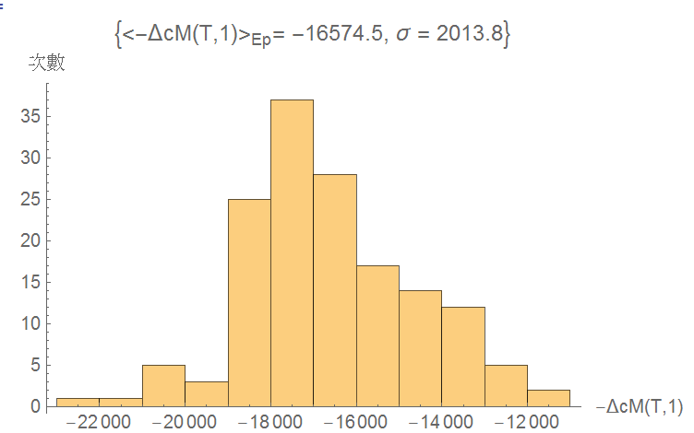
Analysis of open system
5.Interestingly, always be negative which means all the agent lose money to market maker
-ΔC_{M}(T,1)
-18527
-15258
-16173
-19899
-17775

Slide 20
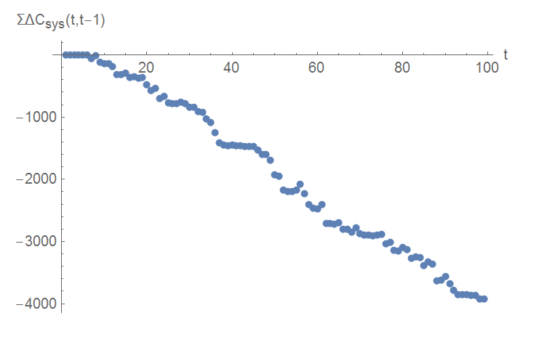
16158 | -33475
13986 | -25117
15587 | -31375
15522 | -30872
16406 | -32375
t A(t) p(t) -n_{M}(t) | 10 -5 9.5 -5 | 11 49 9 -10 | 12 -33 13 39 | 13 5 10.6 6
-ΔC_{M}(t,t-1) | -123 | 45 | -680 | 349
-n_{M}(t) p(t) | -47 | -90 | 541 | 63
Σ-ΔC_{M}(t,t-1) | -95 | -50 | -730 | -381
Σ-ΔC_{M}(t,t-1)+(-n_{M}(t) p(t)) | -143 | -140 | -189 | -317
1.Obviously, total cash flow is negative for long time scle
2.Since cash is non-risky assert, total loss due to the worst action collectively
3.Consequently,in long run, cash flow in open system minority game is negative sum game.

Slide 21
$2 agent & MG agent

Slide 22
$2 agent & MG agent
Instead of MG player,
$2 player will get reward on his strategy on Majority side with next time step(which the same as $-game)
And he will take a round trip in order to profit in short time scale.
We see that,$2 player play a two steps game, in order to compare with MG
player, we need set odd T step(due to the order book)

Slide 23
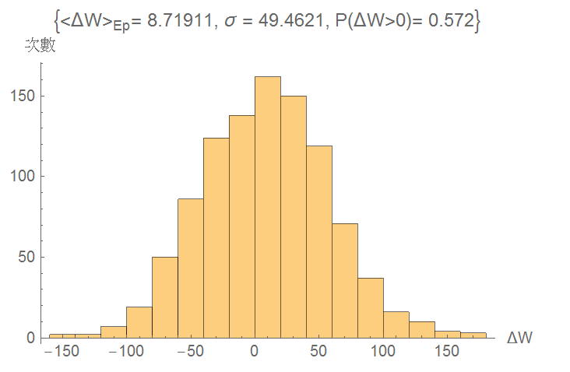
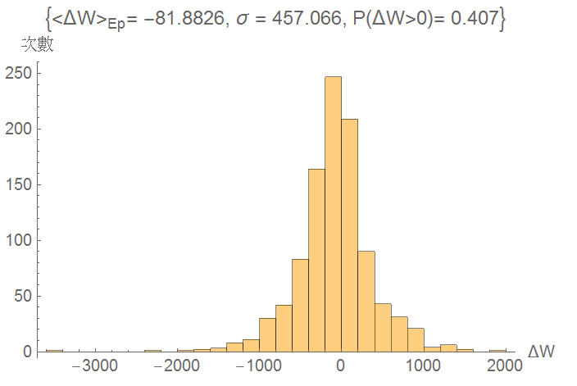
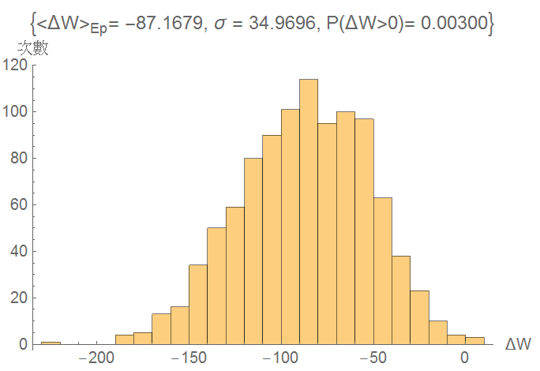
$2 & MG in MG-open system n1=1,n2=1,n3=99,m=2,s=2,T=399 1000 realization
Single realization
$2
Under such a situation that price around p(0)
but loss money due to majority,$2 player loss less than average level mostly due to payoff & round trip rule.
P(ΔW>0) | 1 | 2 | 3 | 4
$2 | 12 | -65 | -52 | 6.7
MG | 348 | -242 | -506 | 249
MG
Under such a situation that price around p(0)
but loss money due to majority, MG player average loss the same with market, but huge fluctuate.

Slide 24
We know that, for a long run, profit form market will consider 3 part below.
n1=1,n2=2,n3=99,m=2,s=2,T=399 Single realization
Consequently,
(1)
$2 player perform better in term ΔC_{i}(T,1)+Δn_{i}(T,1)p(T),in a less risky way
with m=2
(2)
Compare their action due to strategy will
Meaningless unless we have more tool
to analysis p(T) pattern.
ΔW_{i}(T,1) | ΔW_{i}(T,1) | ΔC_{i}(T,1) | n_{i}(1)(p(T)-p(1)) | Δn_{i}(T,1)p(T)
$2 | 13 | -3 | 16 | 0
MG | 348 | 2407 | 16 | -2075
MG-Market | -12670 | -14511 | 1628 | 212
ΔW_{i}(T,1) | ΔW_{i}(T,1) | ΔC_{i}(T,1) | n_{i}(1)(p(T)-p(1)) | Δn_{i}(T,1)p(T)
$2 | -52 | -43 | -9 | 0
MG | -506 | -461 | -9 | -36
MG-Market | -18699 | -17705 | -904 | -90
The difference between 2 agents only on the
Thinking style(round trip rule & payoff).
However,$2 player seems profit very few money even the same order with assert/raise/decay

Slide 25
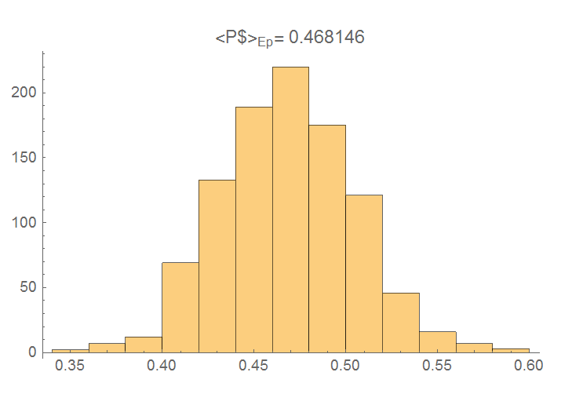
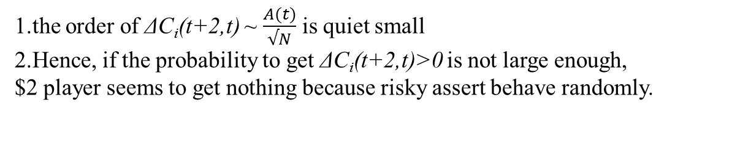
time interval | [5,7] | [7,9] | [9,11] | [11,13]
A(t+1) | 15 | -17 | 3 | -57
 | -1 | -1 | -1 | 1
ΔC_{i}(t+2,t) | -1.5 | 1.7 | -0.3 | -5.7
N=101,m=2,s=2,T=399
1.the order of ΔC_{i}(t+2,t) ~ $\frac{A(t)}{√N}$ is quiet small
2.Hence, if the probability to get ΔC_{i}(t+2,t)>0 is not large enough,
$2 player seems to get nothing because risky assert behave randomly.

Slide 26
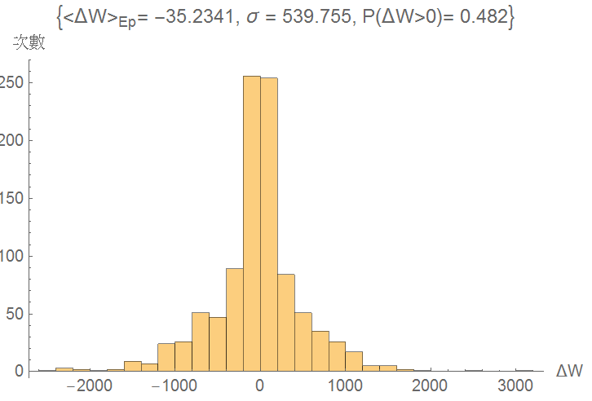
Without round trip constraint $2-$-MG in MG background m=2,s=2
Without round trip constraint,$2 player become purely $ player
Also lose wealth but less in average. Different payoff function give different
action.

Slide 27
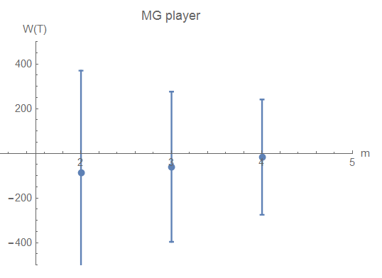
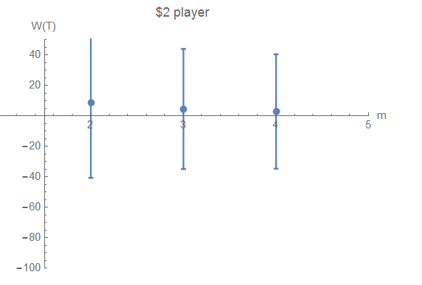
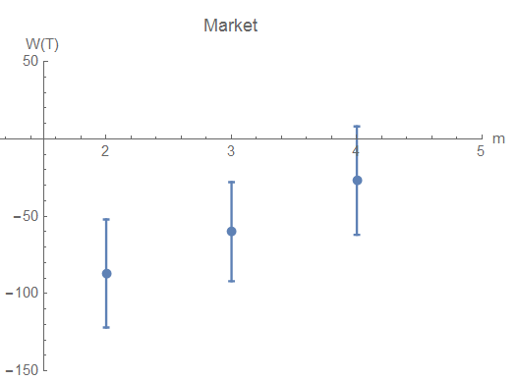
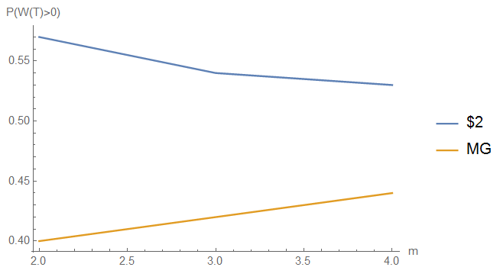
$2 & MG in MG-open system N101 m=2 to m=4,s=2 1000 realization
During m=2 to m=4
The herding effect due to the same prediction with the same economic situation will decay and the Both MG, Market loss decreased accordingly
In such environment,$2player won less cash due to the market fluctuation
And the probability in 1000 realization decrease.

Slide 28
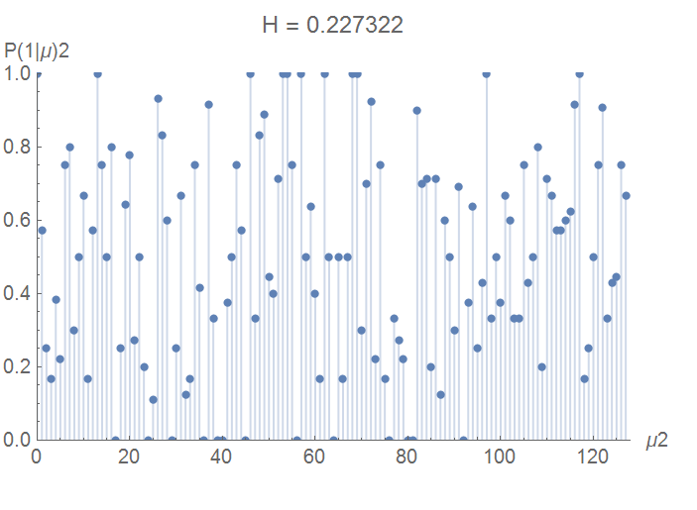
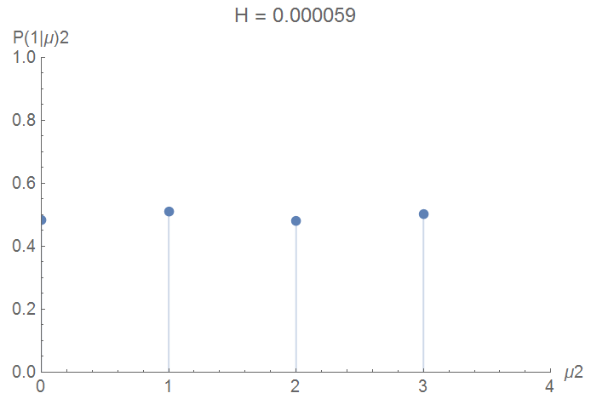
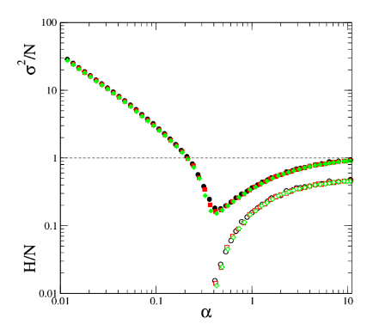
$2 & MG in MG-open system N101 m=7,s=2, α=1.2
in α> α_{c} phase, predictability appear in market
Ex, in economic situation 1 A>0 for all situation
Due to frozen agents?

